Slide 1
CSET301 (AI-ML)
Lecture 21: Normalization, hyperparameter tuning
Deepika Vatsa

Slide 2
Outline
Data normalization
Batch normalization
Hyper parameter Tuning: random, coarse to fine

Slide 3
Data Normalization
Normalization and standardization are pre-processing techniques to have different sources of data inside the same range. Also known as Scaling.
Example: Suppose in buy insurance data set, there are two features: age in years and income in Rs. The range for these input features will be very different; age ranging in 18 to 80 yrs while income ranging from Rs 10-100 (in 1000s).
Notes:
Example: Suppose we have a car rental service. Firstly, we want to predict a fair price for each car based on competitors’ data.
We have two features per car: the age in years and the total amount of kilometers it has been driven for.
These can have very different ranges, ranging from 0 to 15 years, while distance could go from 0 to several hundreds of thousands of kilometers.
We don’t want features to have these differences in ranges, as the value with the higher range might bias our models into giving them inflated importance.

Slide 4
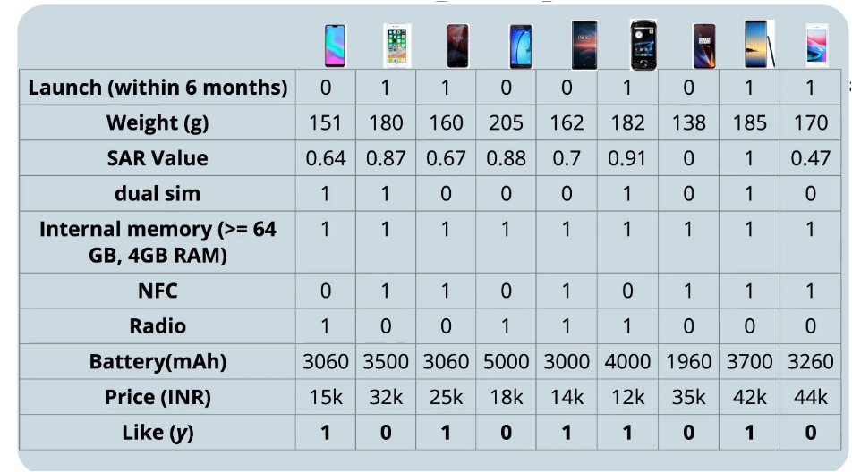
Why Normalization?
Consider this data:
Some input features are in range of 0 – 1 e.g., SAR value, and some are in values of 1000s e.g., Price

Slide 5
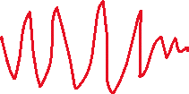
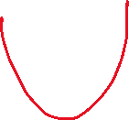


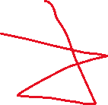
Why Normalization?
If we have input features in different ranges, training of the data becomes difficult.
How?
If we don’t normalize/standardize the data, then there will be two problems:
The weights of some input features (having high range) will be large while for some features (having low range) will be small. [Because gradient of weights of high range features will be a high value, thus weight updates will be large. At every iteration, large updates are made to the weights which will lead to oscillations, which will in turn increase the training time.]
Because of oscillations, it might happen that we overshoot the minima.
Higher range input feature might bias our models into giving them inflated importance. [gradient will move in direction of higher weights]
Notes:
1. W = W – eta(gradient) and we know gradient is dependent on the input, so if input is large, gradient will be large, update made to weights will be large and hence weight will be large.

Slide 6
Why Normalization?
Not normalizing the data before training makes the network drastically harder to train and decreases its learning speed.
The non-normalized data points with wide ranges can cause instability in the network.
The relatively large inputs can cascade down to the layers, causing problems such as exploding gradients.
Data normalization helps in increasing model’s accuracy and decreasing training time

Slide 7
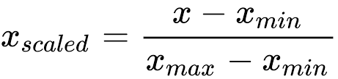
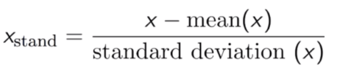
Normalization and Standardization
Min-Max Scaling: Scale it to a range of 0 to 1
Where x: data to normalize
x_{max}: the highest value of x
x_{min} : the lowest value of x
Z-score normalization: 0 mean and 1 std. dev.
Where x: data to normalize
Rescale features such that all data points will have std normal distribution (mean 0 and std. dev. 1)

Slide 8
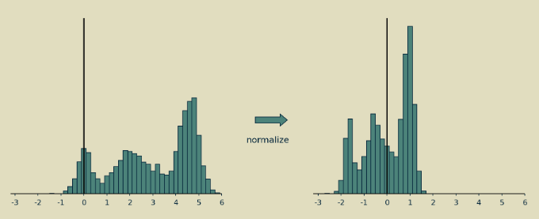
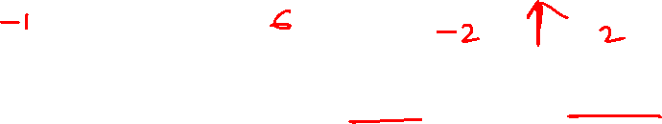
Normalization
Normalized values have 0 mean and unit variance

Slide 9
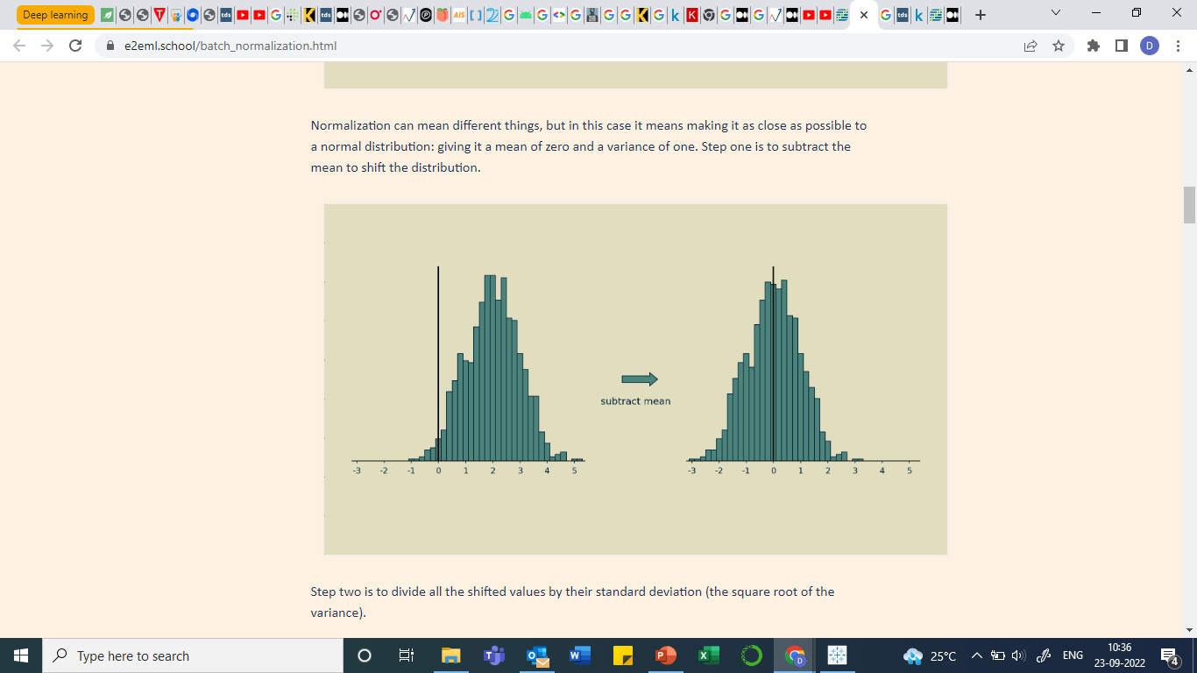
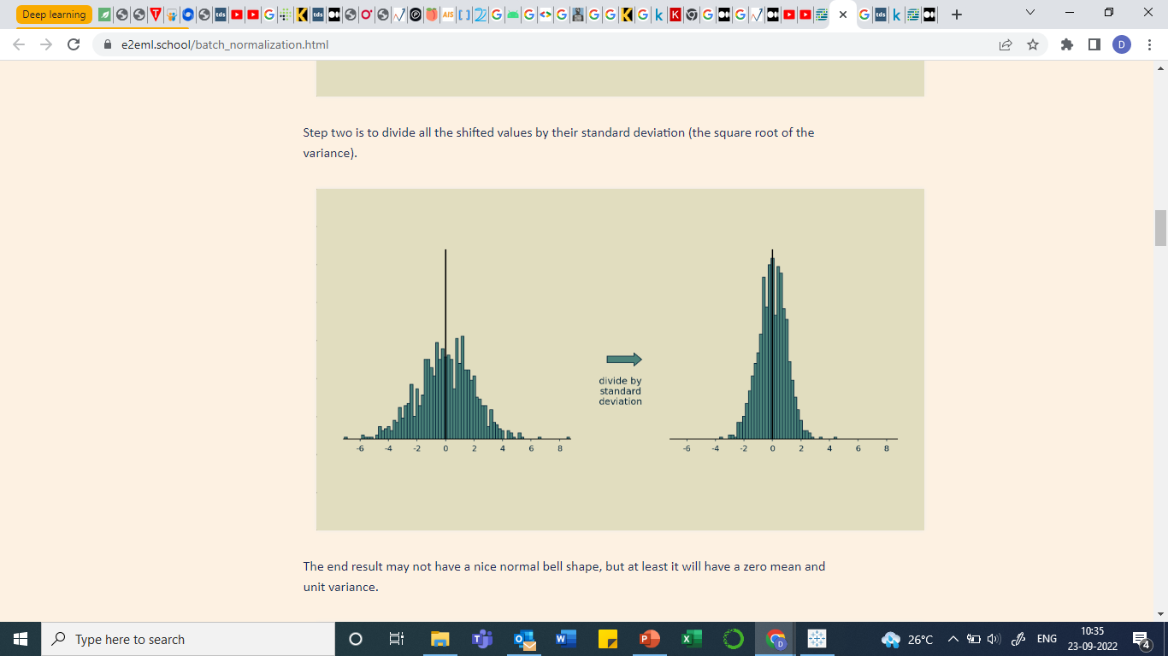
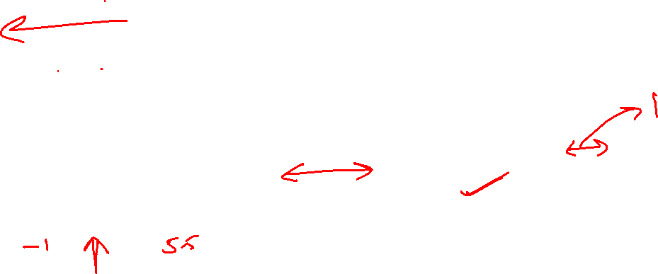
Standardization
Standardized values form a bell shaped curve with 0 mean and variance 1

Slide 10
Batch Normalization
Normalization technique for the hidden units.
Batch normalization normalizes the output of a previous layer by subtracting the batch mean and dividing by the batch standard deviation.
Done on mini-batches
Speed up training
Can be applied to any number of hidden layers.
It can be applied before and after the activation function. However, research shows its best when applied before the activation function.

Slide 11
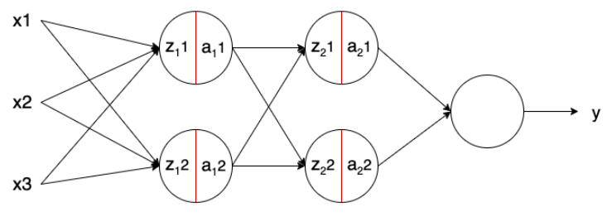


Batch Normalization
Batch Norm is applied to the neurons’ output z just before applying the activation function (at the red line).
Notes:
Here, we have a feed-forward Neural Network:
Where x are the inputs,
z are the net input (input multiplied with weights) / the output of the neurons,
a are the output of the activation functions, and
y is the output of the network:

Slide 12
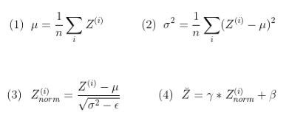
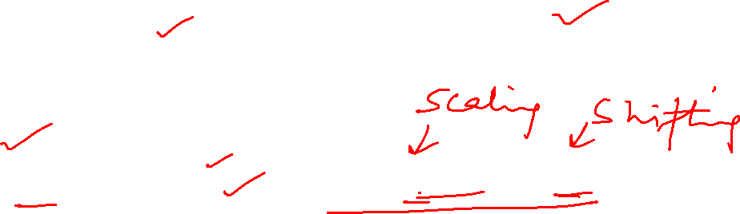
Batch Normalization
  Mean: Mean of batch, Std dev. of batch
  Z: net input
  γ : Scaling factor
  β : Shifting factor
  γ and β
  Used to adjust the distribution.
  Learned over epochs along with w

Slide 13
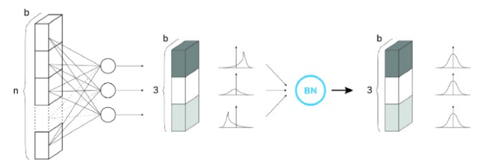
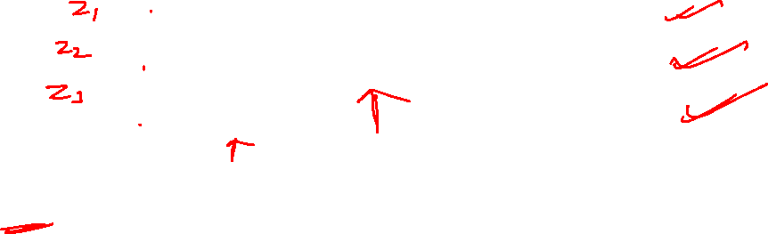

Batch Normalization

Slide 14
Advantages of Batch Normalization
It helps in normalizing the hidden layer and thus speeds up the training process
It ensures that the input for every layer is distributed around the same mean and standard deviation and thus solves the problem of internal covariate shift
Batch Norm has a regularization effect (because applied on mini-batches and not on entire data set).
Notes:
Batch Norm reduces the internal covariate shift of the network. The covariate shift is a change in data distribution. For example, going back to our example on the car rental service, imagine we want to include other motorbikes. If we only look at our previous data set, containing only cars, our model will likely fail to predict motorbikes’ price. This change in data (now containing motorbikes) is named covariate shift, and it is gaining attention as it is a common issue in real-world problems.
These new images will have a slightly different distribution from the previous images. Now the model will change its parameters according to these new images. Hence the distribution of the hidden activation will also change. This change in hidden activation is known as an internal covariate shift.
The internal covariate shift is a change in the input distribution of an internal layer of a Neural Network. For the neurons in an internal layer, the inputs received (from the previous layer) are constantly changing. Applying Batch Norm ensures that the mean and standard deviation of the layer inputs will always remain the same; and , respectively. Thus, the amount of change in the distribution of the input of layers is reduced.
Because it is computed over mini-batches and not the entire data set, the model’s data distribution sees each time has some noise. This can act as a regularizer, which can help overcome overfitting and help learn better. However, the noise added is quite small. Thus, it generally is not enough to properly regularize on its own and is normally used along with Dropout.

Slide 15
Internal Covariate shift
Consider a network that learns a function that maps x to y. The internal covariance shift refers to the change in the distribution of the input x. If a change occurs, our network will not be efficient enough and cant generalize. Thus we will have to train all over.
Example: If we train a network to detect brown dog images and later you end applying this network to data with colored dog images it would not be able to perform well and we would have to train again. This change in the distribution of input is the covariance shift.

Slide 16
Hyperparameters
Hyperparameters are model parameters whose values are set before training.
Until now, we have encountered different hyperparameters:
  learning rate η,
  momentum constant β,
  Adam’s parameters β1, β2, ε
  Batch size b,
  Number of hidden layers
  Number of neurons
Notes:
Examples of hyperparameters in ML is
the number of trees in a random forest or
the penalty intensity of a Lasso regression.
They are all numbers that are set before the training phase and their values affect the behavior of the model.

Slide 17
Hyperparameter tuning
They act as knobs that can be tweaked during the training of the network
Hyperparameter tuning is the process of finding the right values of the hyperparameters, which is a very complex and time-expensive task
Tuning the hyperparameters effectively can lead to massive improvement in the performance of the model.
Two approaches: Grid search and Random search
Notes:
Why should we tune the hyperparameters?
Because we don’t really know their optimal values in advance. A model with different hyperparameters is, actually, a different model so it may have a lower performance.
In the case of neural networks, a low number of neurons could lead to underfitting and a high number could lead to overfitting.
In both cases, the model is not good, so we need to find the intermediate number of neurons that leads to the best performance.
Thus, we need to find the optimal values for these hyperparameters

Slide 18
Approaches of hyperparameter tuning
Grid Search: Try every possible combination of parameters
Steps:
Define a grid on n dimensions, where n is the num of hyperparameters
  e.g. n = (learning_rate, batch_size)
For each dimension, define the range of possible values
  e.g. batch_size = [4, 8, 16, 32], learning_rate =[0.1, 0.01, 0.0001]
Search for all the possible configurations and wait for the results to establish the best one
e.g. C1 = (0.1, 4) -> acc = 92%,
C2 = (0.01, 4) -> acc = 92.3%

Slide 19
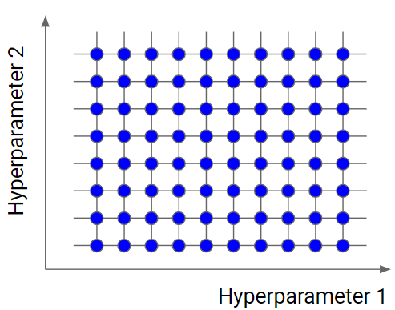
Approaches of hyperparameter tuning
Grid Search: Let’s say we have 2 hyperparameters, one having 8 and another having 10 values. We check all 80 values and pick one value that works best
Slow because it checks every combination.
With more num of hyperparameters, the search will explode in time complexity.
Therefore, used when number of hyperparameters are less than or equal to 4.
Notes:
With more num of dimensions, the search will explode in time complexity. Therefore, used when num of dimensions are less than or equal to 4.
But guarantees the best configuration at the end. Still Not preferred
Grid search is an exhaustive algorithm that spans all the combinations, so it can actually find the best point in the domain.
The great drawback is that it’s very slow. Checking every combination of the space requires a lot of time that, sometimes, time is not available. Don’t forget that every point in the grid needs k-fold cross-validation, which requires k training steps. So, tuning the hyperparameters of a model in this way can be quite complex and expensive.

Slide 20
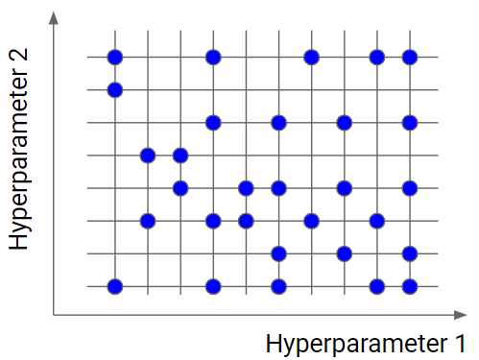
Approaches of hyperparameter tuning
Random Search: Test only randomly selected points on the grid
The smaller this subset, the faster but less accurate the optimization.
The larger this dataset, the more accurate the optimization but the closer to a grid search.
Useful when we have many hyperparameters with fine grained values.
Notes:
Random search is a very useful option when you have several hyperparameters with a fine-grained grid of values. Using a subset made by 5-100 randomly selected points, we are able to get a reasonably good set of values of the hyperparameters.
random search is very useful because it’s faster and, since it doesn’t reach the best point in the grid, it avoids overfitting and is more able to generalize.

Slide 21
References
Hyperparameter tuning
https://www.yourdatateacher.com/2021/05/19/hyperparameter-tuning-grid-search-and-random-search/#:~:text=Random%20search%20is%20similar%20to,closer%20to%20a%20grid%20search.

